Slide 1
The Multiplicative Weights Algorithm
David Woodruff

Slide 2
The Experts Problem
n “experts” predict an outcome on each day
Expert = someone with an opinion, not necessarily someone who knows anything
For example, the experts could try to predict the stock market

Slide 3
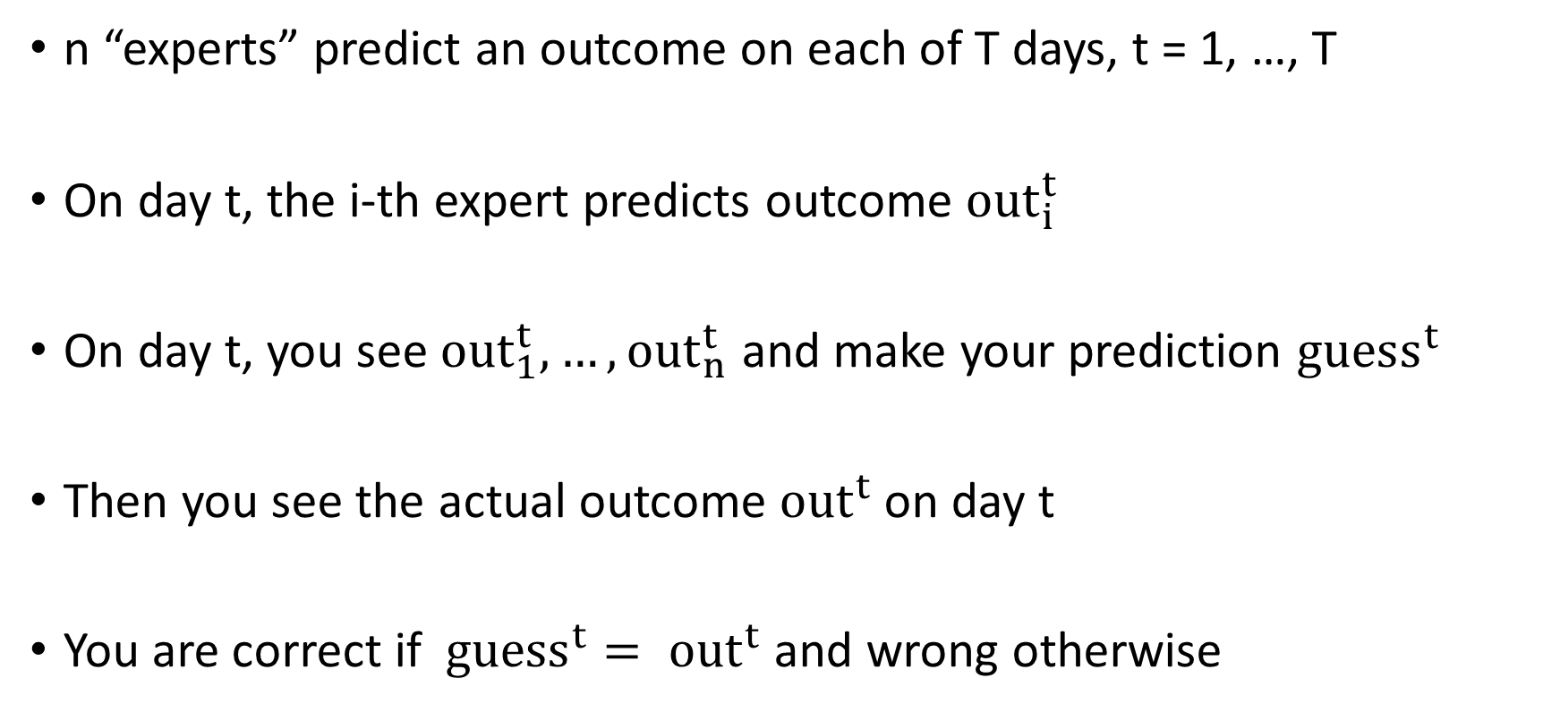
The Experts Problem
n “experts” predict an outcome on each of T days, t = 1, …, T
On day t, the i-th expert predicts outcome $out_{i}^{t}$
On day t, you see $out_{1}^{t}, …, out_{n}^{t}$ and make your prediction $guess^{t}$
Then you see the actual outcome $out^{t}$ on day t
You are correct if ${guess}^{t}= out^{t}$ and wrong otherwise

Slide 4
The Experts Problem
Goal: if the best expert is wrong on M days, you want to be wrong on at most M days, plus a little bit
Don’t make assumptions on the input
Don’t assume future looks like the past
You want to do as well as the best single expert in hindsight
How should you choose your guess on each day?

Slide 5
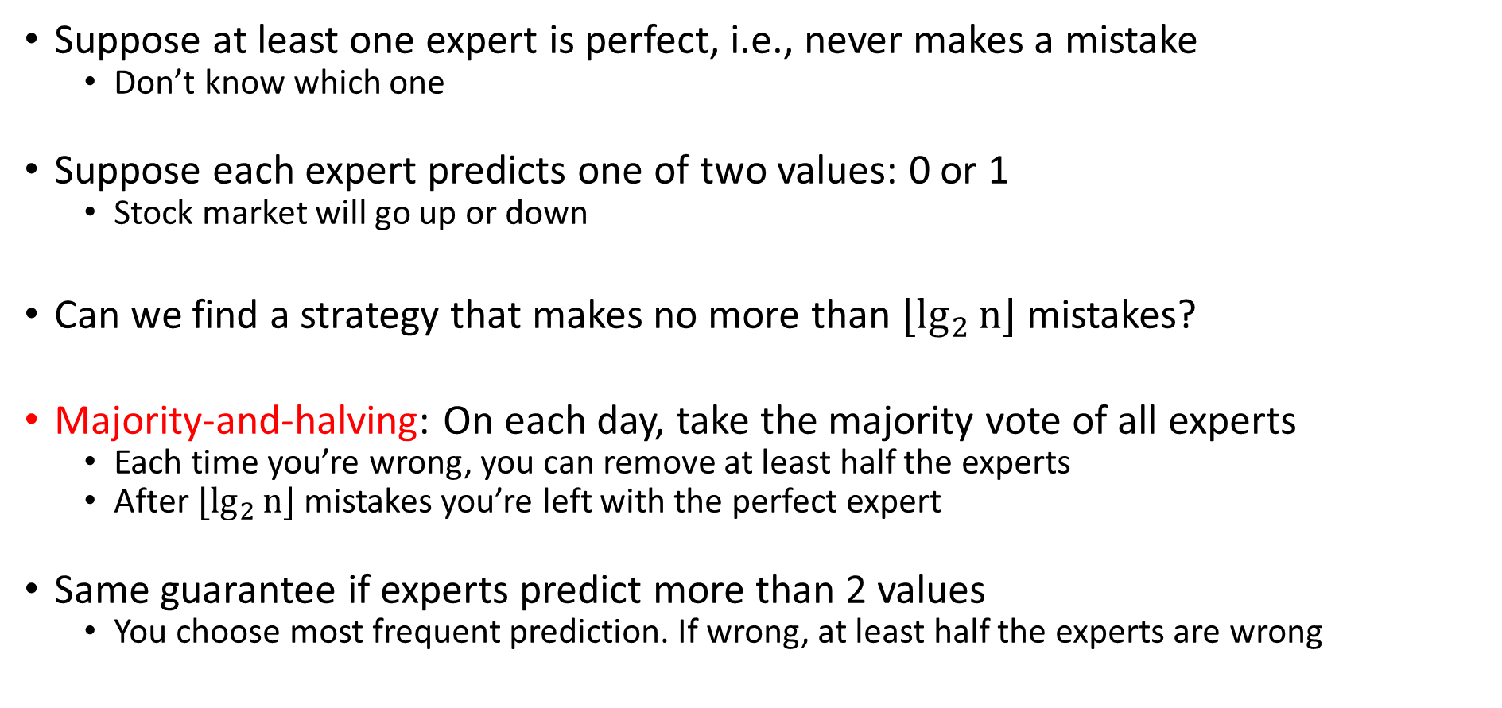
Simpler Question
Suppose at least one expert is perfect, i.e., never makes a mistake
  Don’t know which one
Suppose each expert predicts one of two values: 0 or 1
  Stock market will go up or down
Can we find a strategy that makes no more than $⌊\lg_{2}{n}⌋$ mistakes?
Majority-and-halving: On each day, take the majority vote of all experts
  Each time you’re wrong, you can remove at least half the experts
  After $⌊\lg_{2}{n}⌋$ mistakes you’re left with the perfect expert
Same guarantee if experts predict more than 2 values
  You choose most frequent prediction. If wrong, at least half the experts are wrong

Slide 6
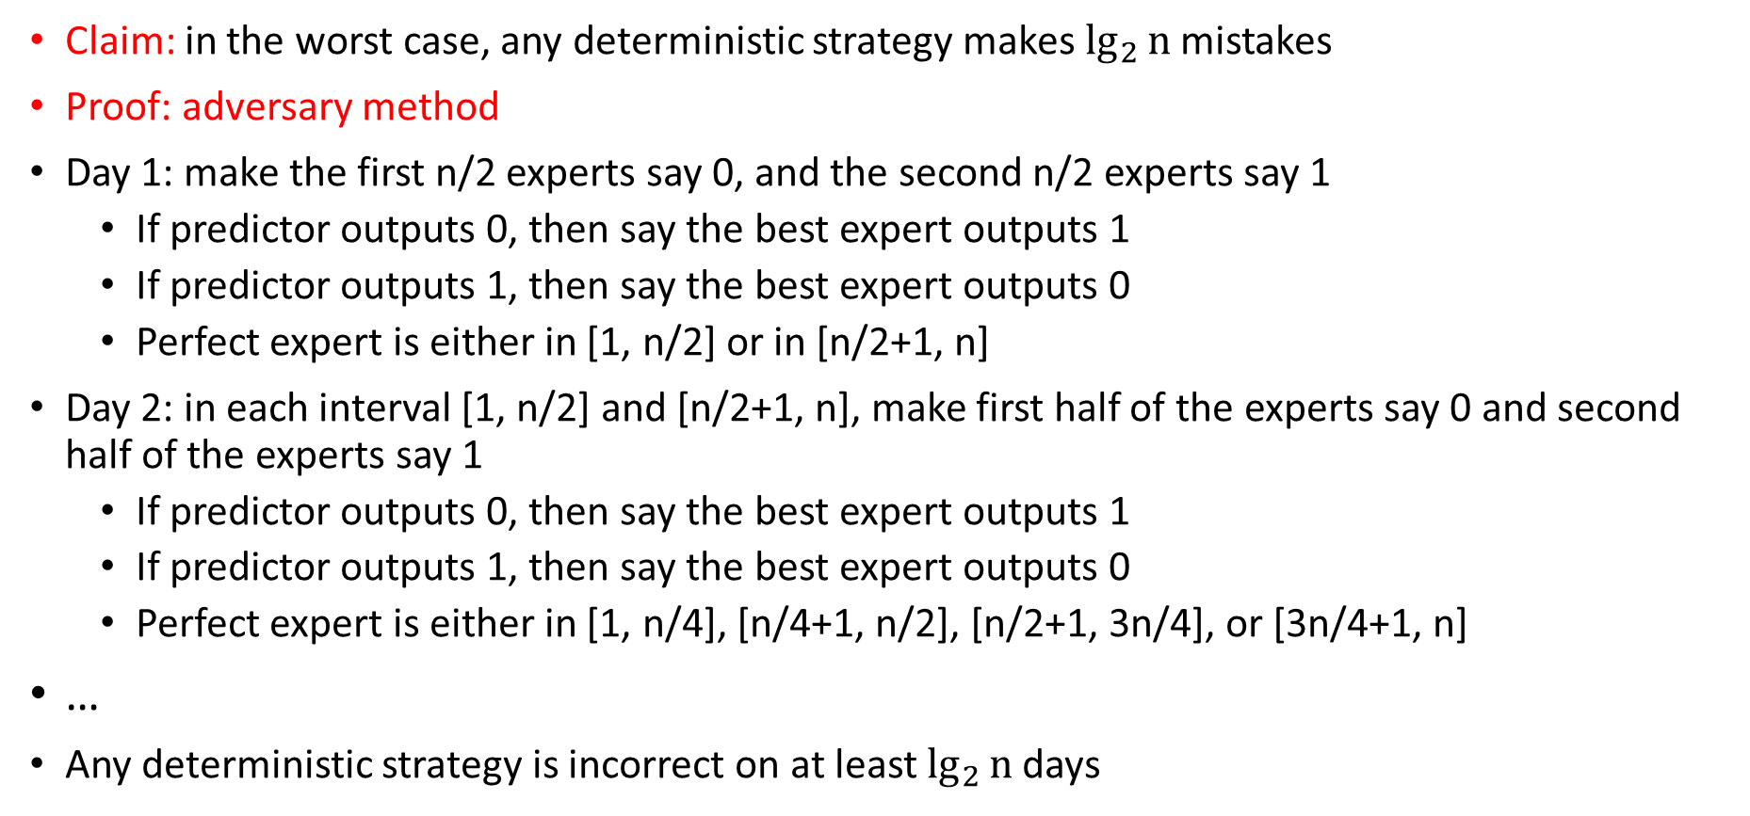
Can You Do Better?
Claim: in the worst case, any deterministic strategy makes $\lg_{2}{n}$ mistakes
Proof: adversary method
Day 1: make the first n/2 experts say 0, and the second n/2 experts say 1
  If predictor outputs 0, then say the best expert outputs 1
  If predictor outputs 1, then say the best expert outputs 0
  Perfect expert is either in [1, n/2] or in [n/2+1, n]
Day 2: in each interval [1, n/2] and [n/2+1, n], make first half of the experts say 0 and second half of the experts say 1
  If predictor outputs 0, then say the best expert outputs 1
  If predictor outputs 1, then say the best expert outputs 0
  Perfect expert is either in [1, n/4], [n/4+1, n/2], [n/2+1, 3n/4], or [3n/4+1, n]
…
Any deterministic strategy is incorrect on at least$\lg_{2}{n}$ days

Slide 7
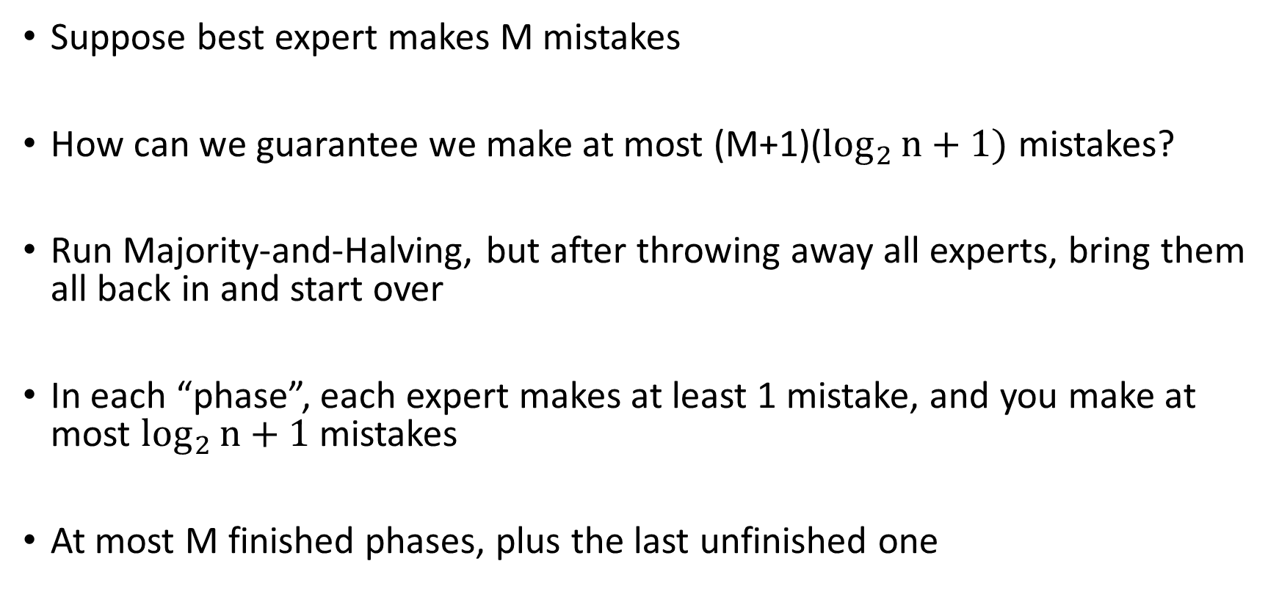
No Perfect Expert
Suppose best expert makes M mistakes
How can we guarantee we make at most (M+1)($\log_{2}{n}+1)$ mistakes?
Run Majority-and-Halving, but after throwing away all experts, bring them all back in and start over
In each “phase”, each expert makes at least 1 mistake, and you make at most $\log_{2}{n}+1$ mistakes
At most M finished phases, plus the last unfinished one

Slide 8
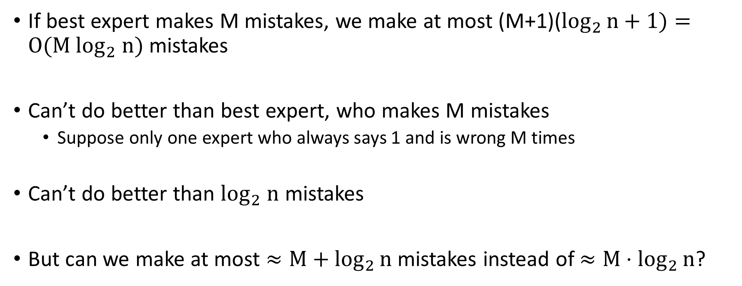
Doing Better
If best expert makes M mistakes, we make at most (M+1)($\log_{2}{n}+1)=O(M \log_{2} n)$ mistakes
Can’t do better than best expert, who makes M mistakes
  Suppose only one expert who always says 1 and is wrong M times
Can’t do better than $\log_{2} n$ mistakes
But can we make at most $≈M+\log_{2}{n}$ mistakes instead of $≈M⋅\log_{2}{n}$?

Slide 9
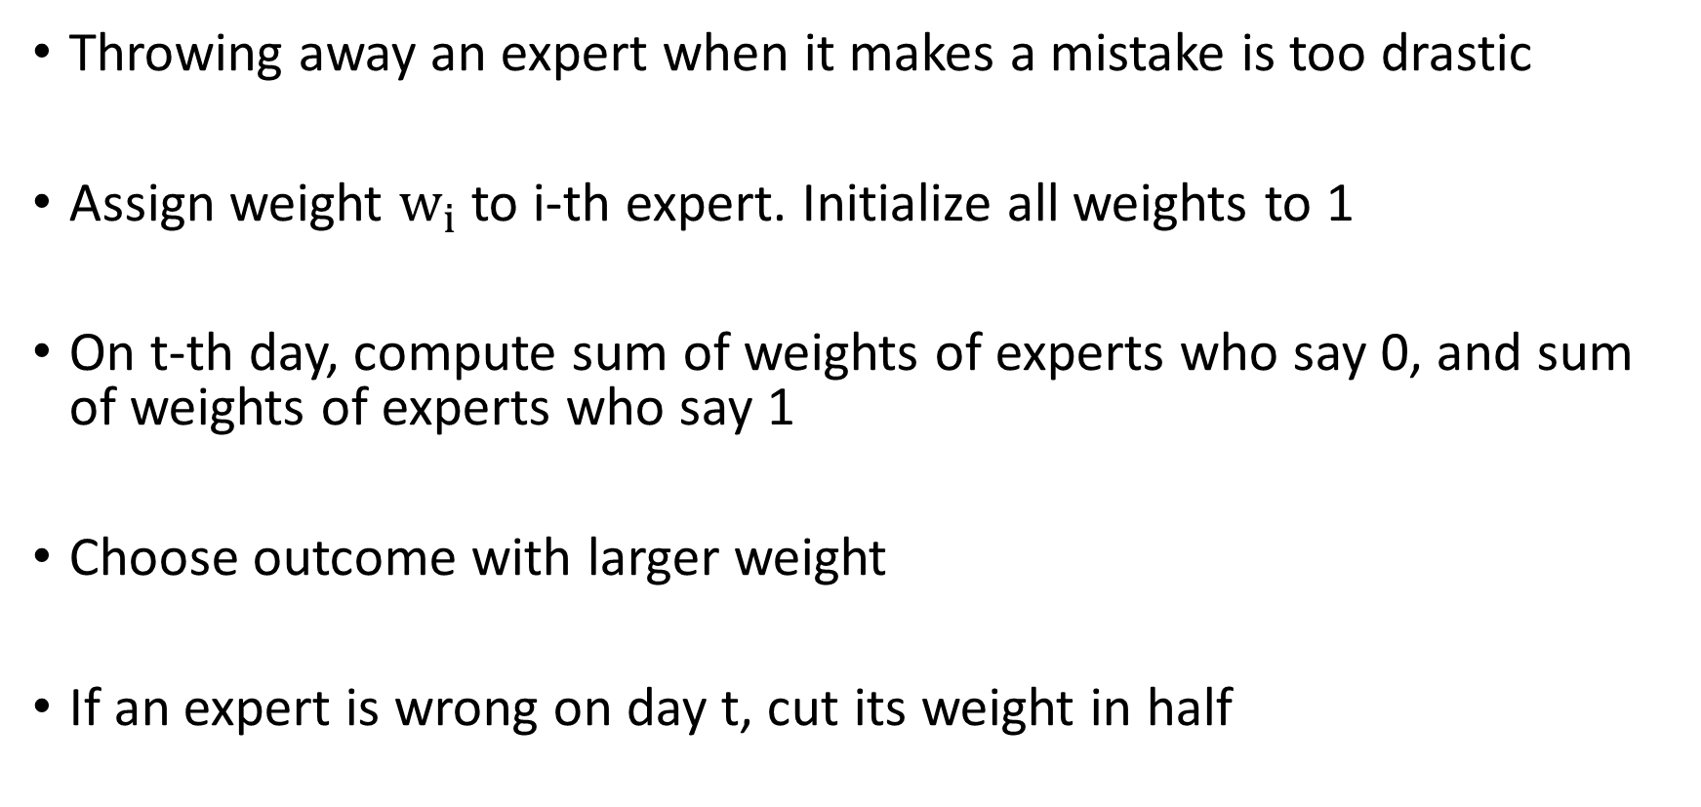
Weighted Majority Algorithm
Throwing away an expert when it makes a mistake is too drastic
Assign weight $w_{i}$ to i-th expert. Initialize all weights to 1
On t-th day, compute sum of weights of experts who say 0, and sum of weights of experts who say 1
Choose outcome with larger weight
If an expert is wrong on day t, cut its weight in half

Slide 10
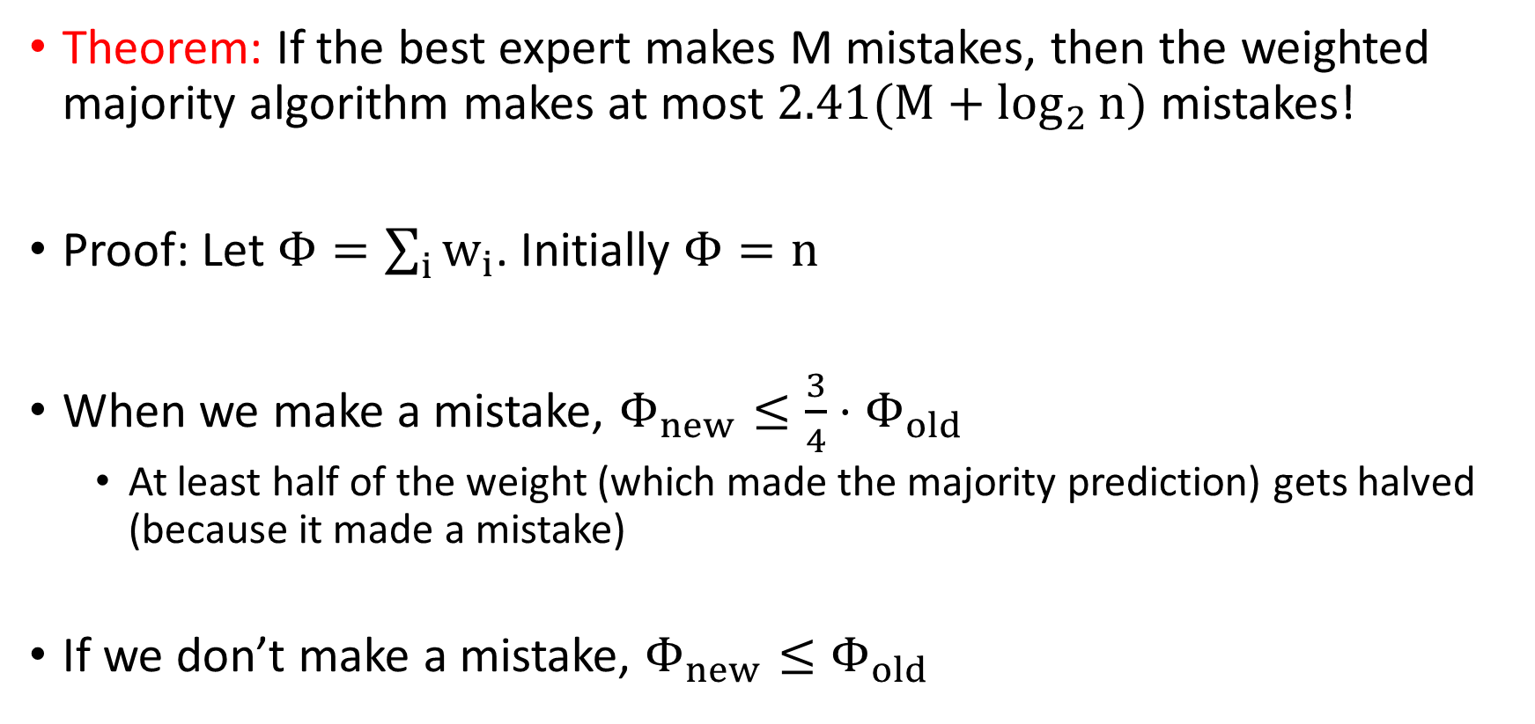
Weighted Majority Algorithm
Theorem: If the best expert makes M mistakes, then the weighted majority algorithm makes at most $2.41(M+\log_{2}{n)}$ mistakes!
Proof: Let $Φ=\sum_{i}{w_{i}}$. Initially $Φ=n$
When we make a mistake, $Φ_{new}≤\frac{3}{4}{⋅Φ}_{old}$
  At least half of the weight (which made the majority prediction) gets halved (because it made a mistake)
If we don’t make a mistake, $Φ_{new}≤Φ_{old}$

Slide 11
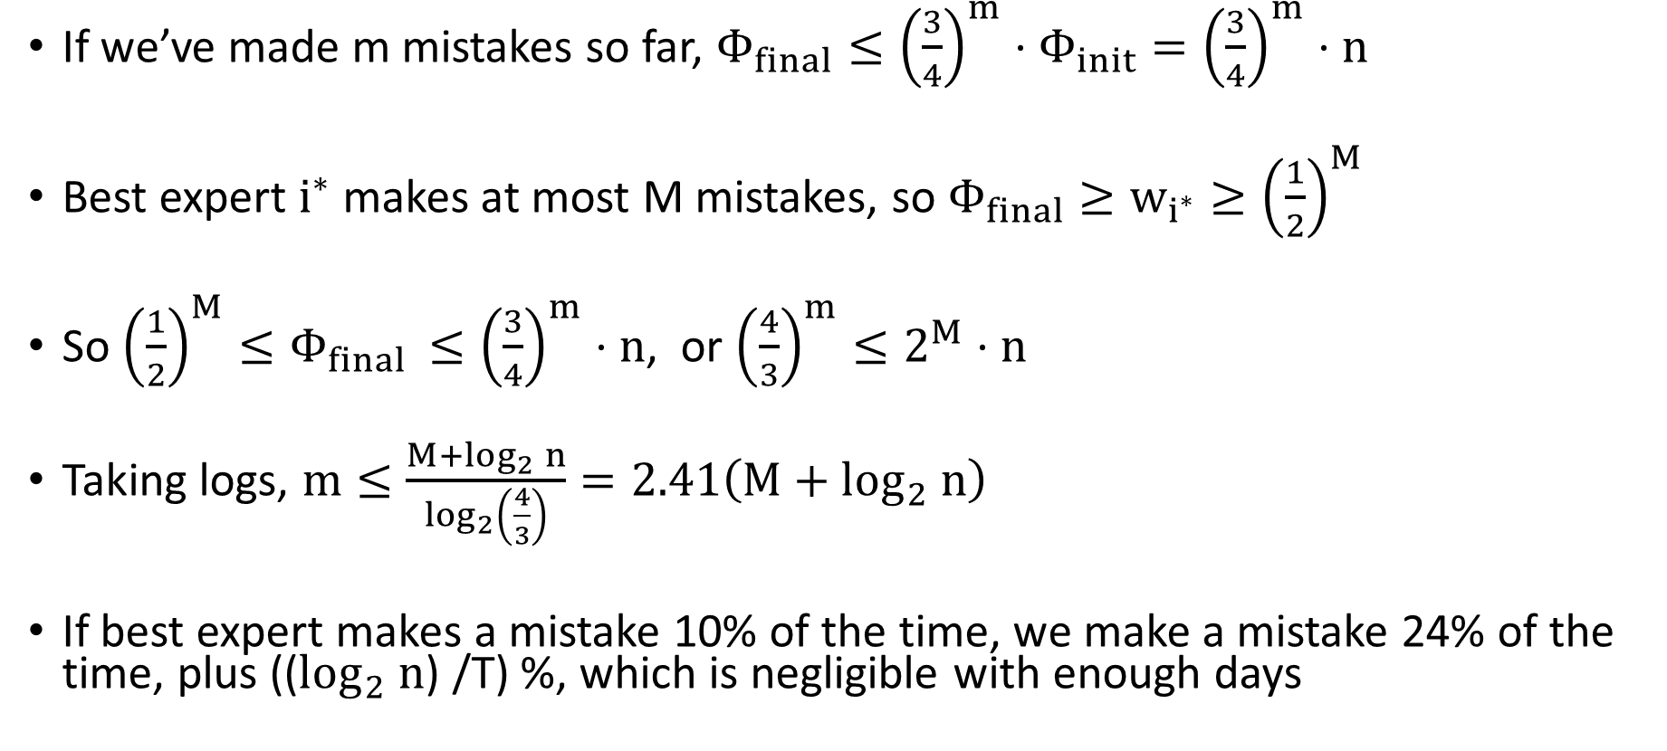
Weighted Majority Algorithm
If we’ve made m mistakes so far, $Φ_{final}≤{\left(\frac{3}{4}\right)}^{m}⋅Φ_{init}={\left(\frac{3}{4}\right)}^{m}⋅n$
Best expert $i^{∗}$ makes at most M mistakes, so $Φ_{final}≥w_{i^{∗}}≥{\left(\frac{1}{2}\right)}^{M}$
So ${\left(\frac{1}{2}\right)}^{M}≤Φ_{final }≤{\left(\frac{3}{4}\right)}^{m}⋅n$, or ${\left(\frac{4}{3}\right)}^{m}≤2^{M}⋅n$
Taking logs, $m≤\frac{M+\log_{2}{n}}{\log_{2}\left(\frac{4}{3}\right)}=2.41\left(M+\log_{2} n\right)$
If best expert makes a mistake 10% of the time, we make a mistake 24% of the time, plus (($\log_{2} n$) /T) %, which is negligible with enough days

Slide 12
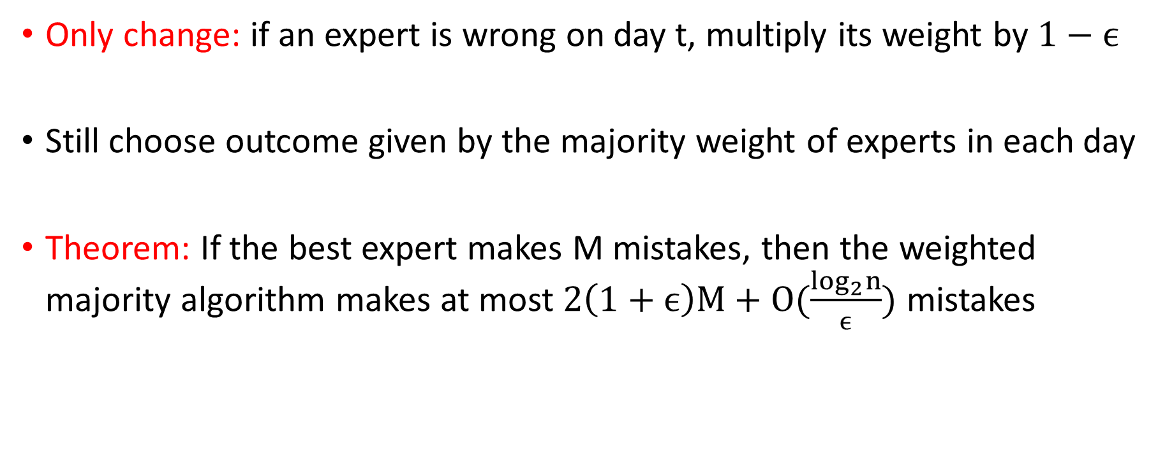
Improved Weighted Majority Algorithm
Only change: if an expert is wrong on day t, multiply its weight by $1−ϵ$
Still choose outcome given by the majority weight of experts in each day
Theorem: If the best expert makes M mistakes, then the weighted majority algorithm makes at most $2\left(1+ϵ\right)M+O(\frac{\log_{2}n}{ϵ})$ mistakes

Slide 13
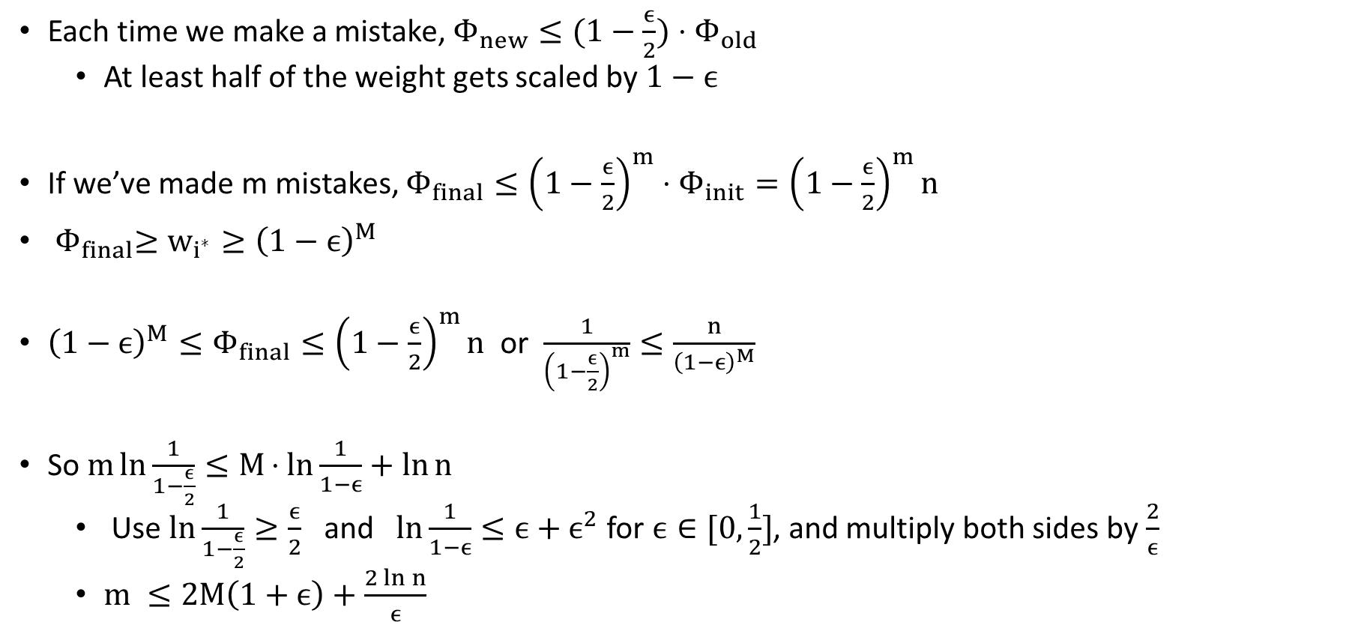
Improved Weighted Majority Algorithm
Each time we make a mistake, $Φ_{new}≤(1−\frac{ϵ}{2}){⋅Φ}_{old}$
  At least half of the weight gets scaled by $1−ϵ$
If we’ve made m mistakes, $Φ_{final}≤{\left(1−\frac{ϵ}{2}\right)}^{m}⋅Φ_{init}={\left(1−\frac{ϵ}{2}\right)}^{m}n$
${ Φ}_{final}≥w_{i^{∗}}≥{\left(1−ϵ\right)}^{M}$
${\left(1−ϵ\right)}^{M}≤Φ_{final}≤{\left(1−\frac{ϵ}{2}\right)}^{m}n$ or $\frac{1}{{\left(1−\frac{ϵ}{2}\right)}^{m}}≤\frac{n}{{\left(1−ϵ\right)}^{M}}$
So $m\ln{\frac{1}{1−\frac{ϵ}{2}}}≤M⋅ln{\frac{1}{1−ϵ}+\ln{n}}$
  Use $\ln{\frac{1}{1−\frac{ϵ}{2}}}≥\frac{ϵ}{2}$ and $\ln{\frac{1}{1−ϵ}}≤ϵ+ϵ^{2}$ for $ϵ∈[0,\frac{1}{2}]$, and multiply both sides by $\frac{2}{ϵ}$
  $m ≤2M\left(1+ϵ\right)+\frac{2\ln{n}}{ϵ}$

Slide 14
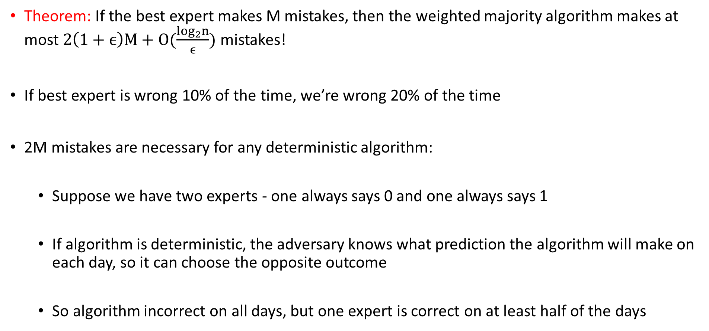
Lower Bound for Deterministic Algorithms
Theorem: If the best expert makes M mistakes, then the weighted majority algorithm makes at most $2\left(1+ϵ\right)M+O(\frac{\log_{2}n}{ϵ})$ mistakes!
If best expert is wrong 10% of the time, we’re wrong 20% of the time
2M mistakes are necessary for any deterministic algorithm:
  Suppose we have two experts - one always says 0 and one always says 1
  If algorithm is deterministic, the adversary knows what prediction the algorithm will make on each day, so it can choose the opposite outcome
  So algorithm incorrect on all days, but one expert is correct on at least half of the days

Slide 15
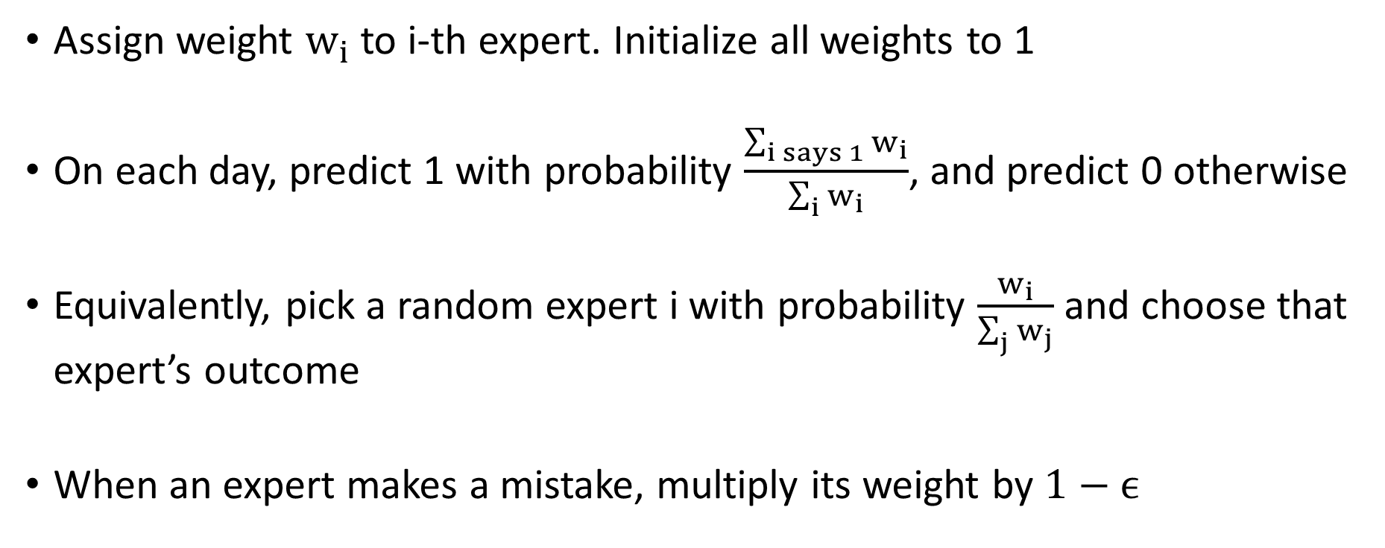
Randomized Weighted Majority Algorithm
Assign weight $w_{i}$ to i-th expert. Initialize all weights to 1
On each day, predict 1 with probability $\frac{\sum_{i says 1}{w_{i}}}{\sum_{i}{w_{i}}}$, and predict 0 otherwise
Equivalently, pick a random expert i with probability $\frac{w_{i}}{\sum_{j}{w_{j}}}$ and choose that expert’s outcome
When an expert makes a mistake, multiply its weight by $1−ϵ$

Slide 16
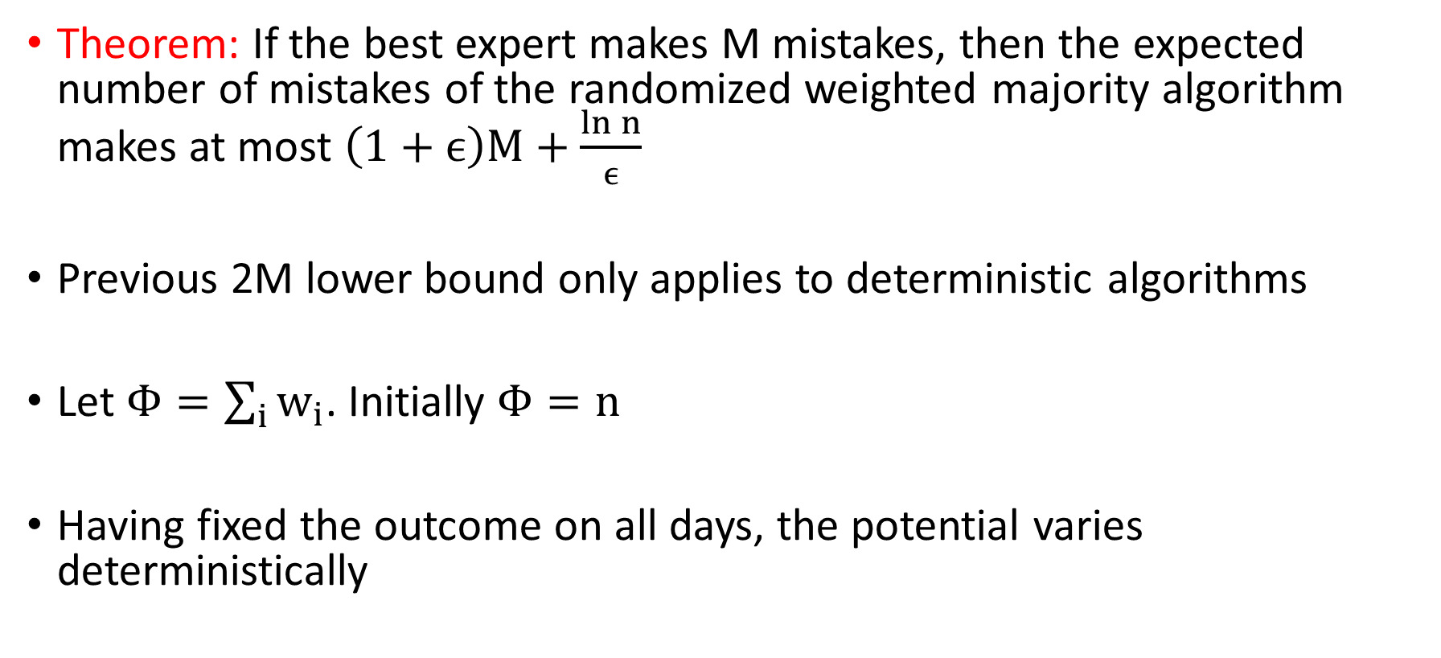
Randomized Weighted Majority Algorithm
Theorem: If the best expert makes M mistakes, then the expected number of mistakes of the randomized weighted majority algorithm makes at most $\left(1+ϵ\right)M+\frac{ln n}{ϵ}$
Previous 2M lower bound only applies to deterministic algorithms
Let $Φ=\sum_{i}{w_{i}}$. Initially $Φ=n$
Having fixed the outcome on all days, the potential varies deterministically

Slide 17
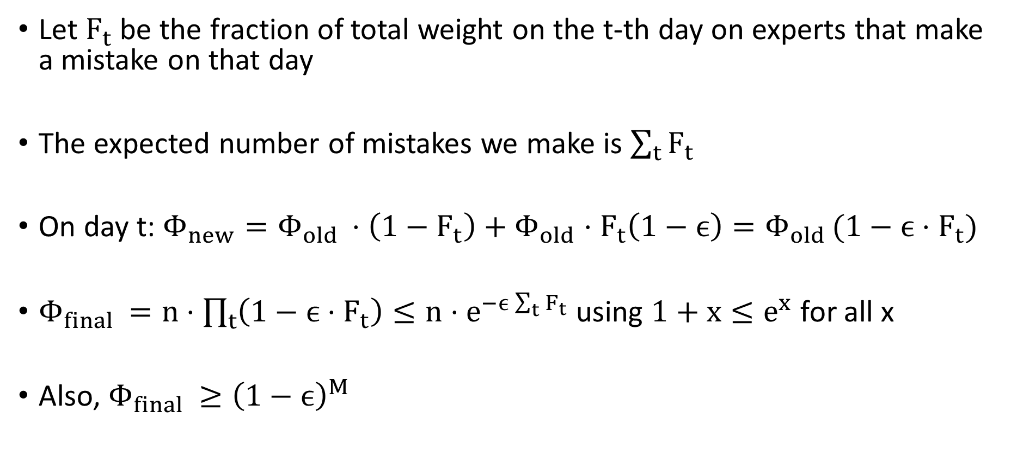
Randomized Weighted Majority Algorithm
Let $F_{t}$ be the fraction of total weight on the t-th day on experts that make a mistake on that day
The expected number of mistakes we make is $\sum_{t}{F_{t}}$
On day t: $Φ_{new}=Φ_{old }⋅\left(1−F_{t}\right)+Φ_{old}⋅F_{t}\left(1−ϵ\right)=Φ_{old }(1−ϵ{⋅F}_{t})$
$Φ_{final }=n⋅\prod_{t}{\left(1−ϵ⋅F_{t}\right)}≤n⋅e^{−ϵ\sum_{t}{F_{t}}}$using $1+x≤e^{x}$ for all x
Also, $Φ_{final }≥{\left(1−ϵ\right)}^{M}$

Slide 18
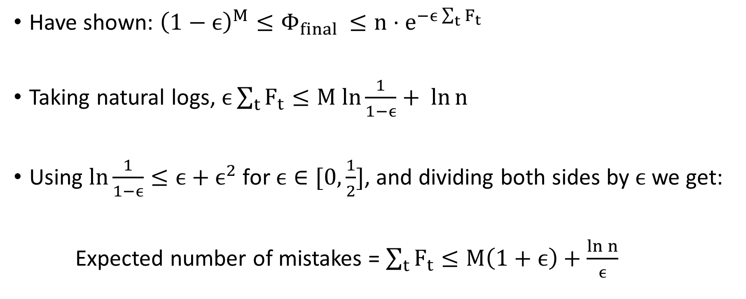
Randomized Weighted Majority Algorithm
Have shown: ${{\left(1−ϵ\right)}^{M}≤Φ}_{final }≤n⋅e^{−ϵ\sum_{t}{F_{t}}}$
Taking natural logs, $ϵ\sum_{t}{F_{t}≤M ln\frac{1}{1−ϵ}+ ln{n }}$
Using $\ln{\frac{1}{1−ϵ}}≤ϵ+ϵ^{2}$ for $ϵ∈[0,\frac{1}{2}]$, and dividing both sides by $ϵ$ we get:
Expected number of mistakes = $\sum_{t}{F_{t}}≤M\left(1+ϵ\right)+\frac{\ln{n}}{ϵ}$

Slide 19
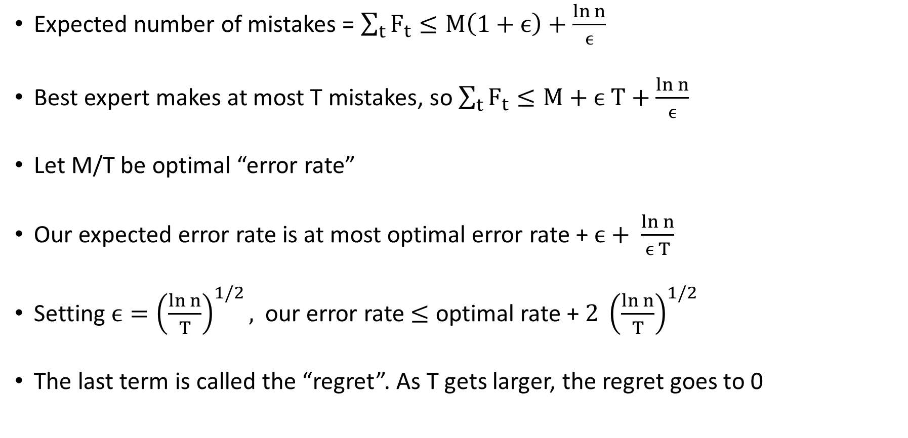
Understanding the Error Rate
Expected number of mistakes = $\sum_{t}{F_{t}}≤M\left(1+ϵ\right)+\frac{\ln{n}}{ϵ}$
Best expert makes at most T mistakes, so $\sum_{t}{F_{t}}≤M+ϵ T+\frac{\ln{n}}{ϵ}$
Let M/T be optimal “error rate”
Our expected error rate is at most optimal error rate + $ϵ+ \frac{\ln{n}}{ϵ T}$
Setting $ϵ={\left(\frac{\ln{n}}{T}\right)}^{1/2},$ our error rate $≤$ optimal rate + $2 {\left(\frac{\ln{n}}{T}\right)}^{1/2}$
The last term is called the “regret”. As T gets larger, the regret goes to 0

